Slide 1

Building an Assembly Line for Data and AI-Driven Insight
Jing Liu, Executive Director
The Michigan Institute for Data Science
University of Michigan
Dec. 5, 2023

Slide 2


University of Michigan
8000 faculty members and 50,000 students.
110 Graduate programs among top 10 in the US.
>$1.7B annual research expenditure.
#1 (sometimes #2 or #3) public university by various ranking systems.
Currently No. 1 in Big 10 football.
Notes:
Very, very brief explanation.

Slide 3
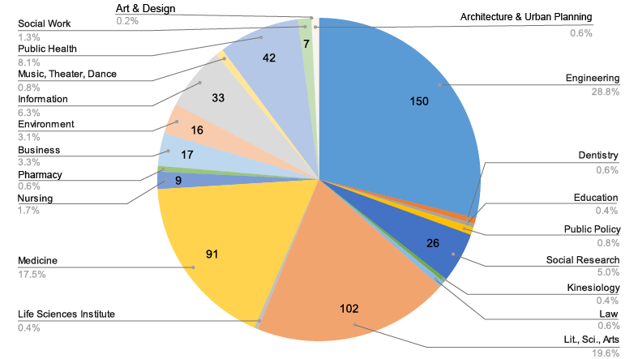
Michigan Institute for Data Science
530+ faculty affiliates, making us the largest data science and AI institute at a US university and one of the most scientifically diverse.
>1000 students and postdoctoral trainees in our community.
Notes:
Very, very brief explanation.

Slide 4
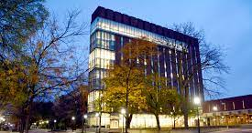
What we do
To catalyze the transformative use of data science and AI in a wide range of disciplines to achieve lasting scientific and societal impact.
Responsible data science and AI
Using new data types to understand human behavior and society
Cutting-edge data analytics for health intervention
AI in science and engineering
Emerging strengths - environment and sustainability
Research pillars

Slide 5

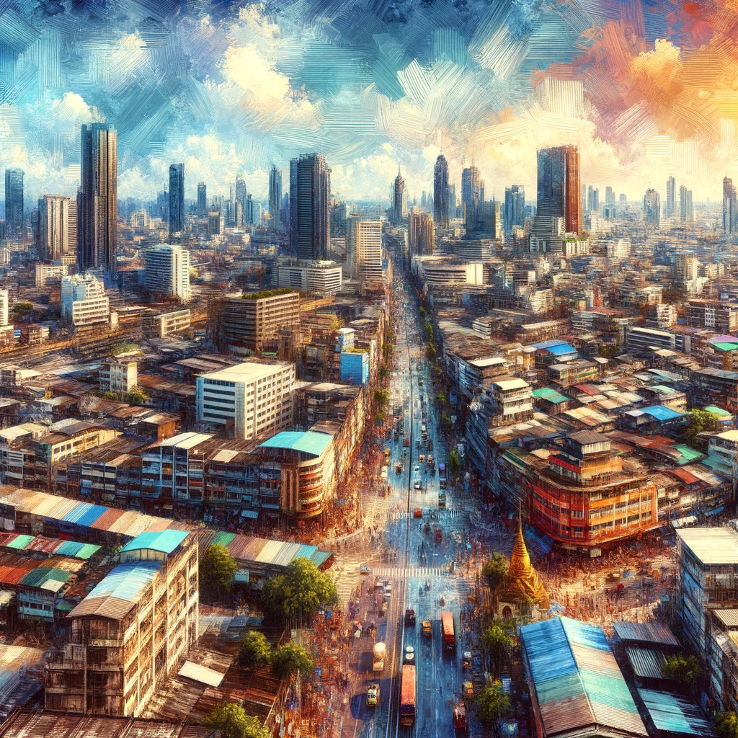

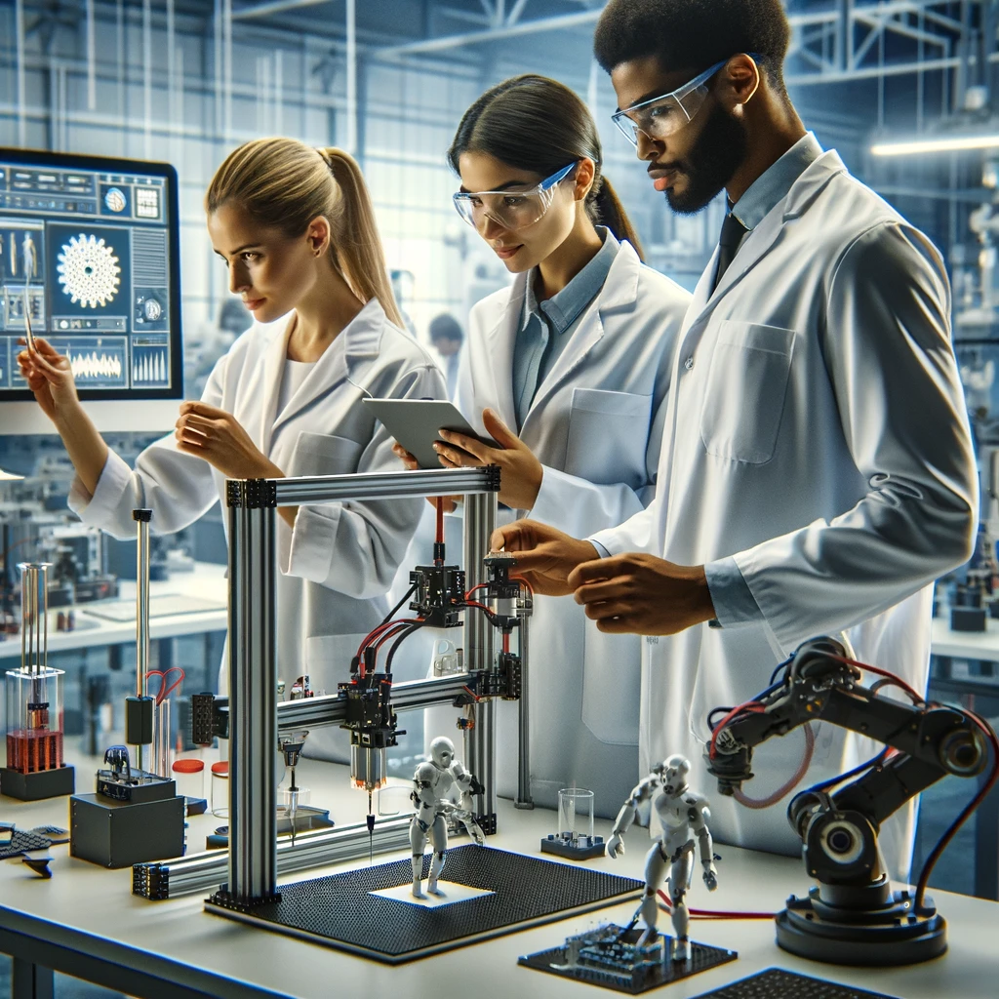
Why I’m here
(Image credit: Dalle-3)

Slide 6
Why I’m here
Academia and industry are facing very similar challenges
(Image credit: Dalle-3)

Slide 7
What I will cover
?
?
It’s time for an assembly line for research and insight.
But there is an implementation gap for a virtuous cycle of data, AI and insight.
How to fill the implementation gap with a new model of collaboration between academia, industry and government.
?
?
?
?
?
?

Slide 8
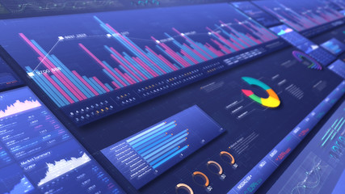



The virtuous cycle of data and AI for insight

Slide 9

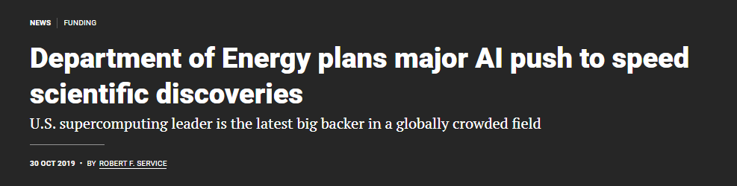
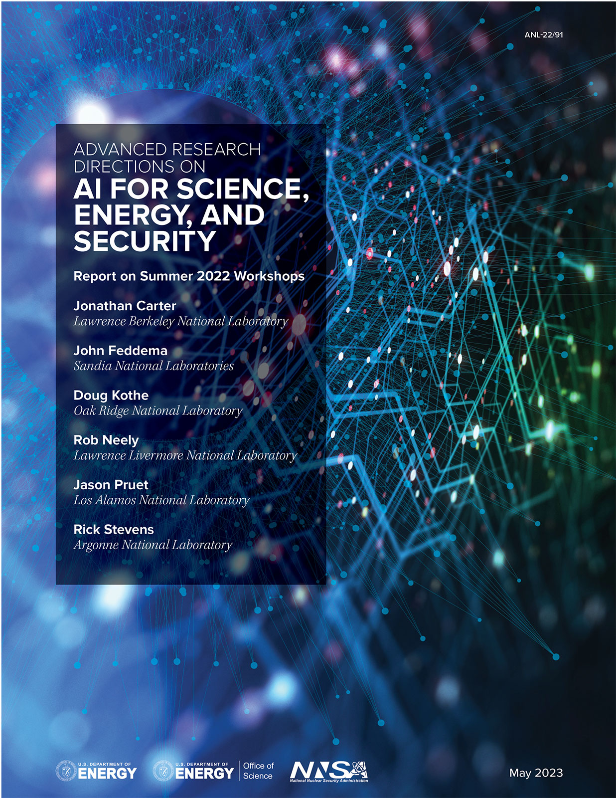
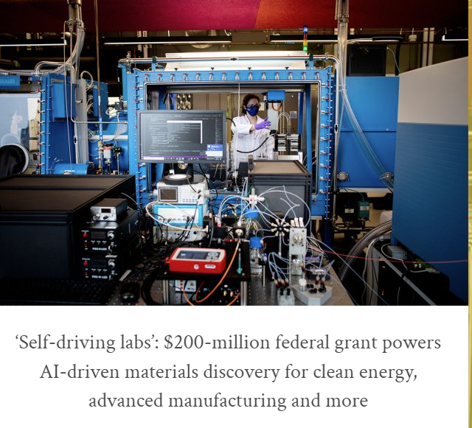
An assembly line for experimentation

Slide 10
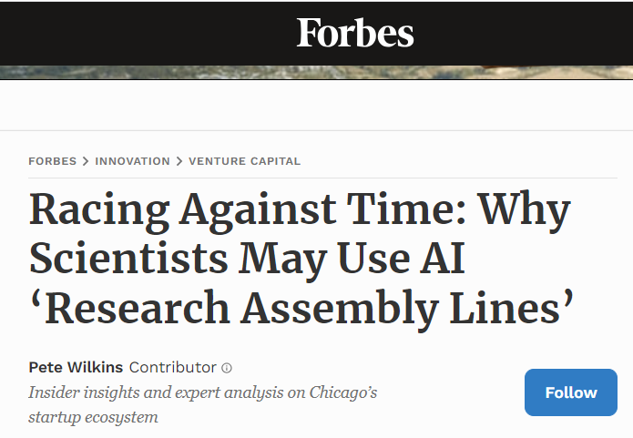
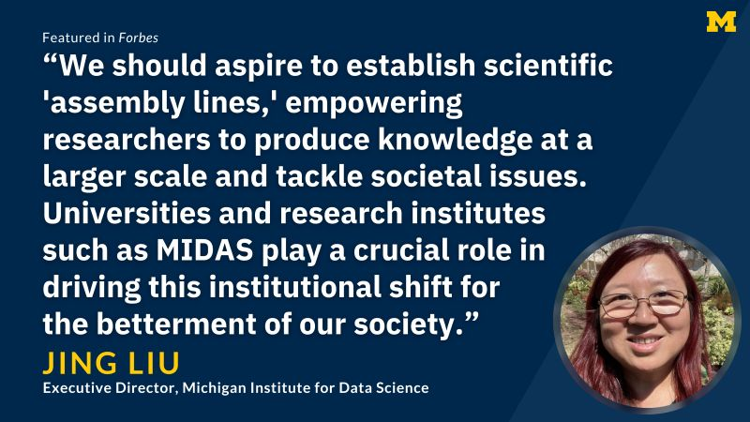
An assembly line for knowledge and insight?
Using AI to replace the human hand, and to expand the human brain.
Do what we do faster and better; and do what we are not capable of doing yet.

Slide 11
Data and AI -driven knowledge assembly line
Literature search
Primary
Secondary
Labeling / annotation
Modeling
Explainability
Experimentation
Query
Summary of status
Imputation and extrapolation
Statistics
Virtual instruments
Reporting
Scraping
Research design
Data fusion / formatting
Feature / pattern detection
Simulation
Selection
Problem
Data collection
Data processing
Analysis / modeling
Interpretation

Slide 12
Data and AI -driven knowledge assembly line
Design & optimization
Provenance
Access
Monitoring
Updating
Literature search
Primary
Secondary
Labeling / annotation
Modeling
Explainability
Experimentation
Query
Summary of status
Imputation and extrapolation
Statistics
Virtual instruments
Reporting
Scraping
Research design
Data fusion / formatting
Feature / pattern detection
Simulation
Selection
Problem
Data collection
Data processing
Analysis / modeling
Interpretation
Design & optimization
Provenance
Access
Monitoring
Updating

Slide 13
The implementation gap

Slide 14
The implementation gap
The potential of AI
The risk of AI

Slide 15
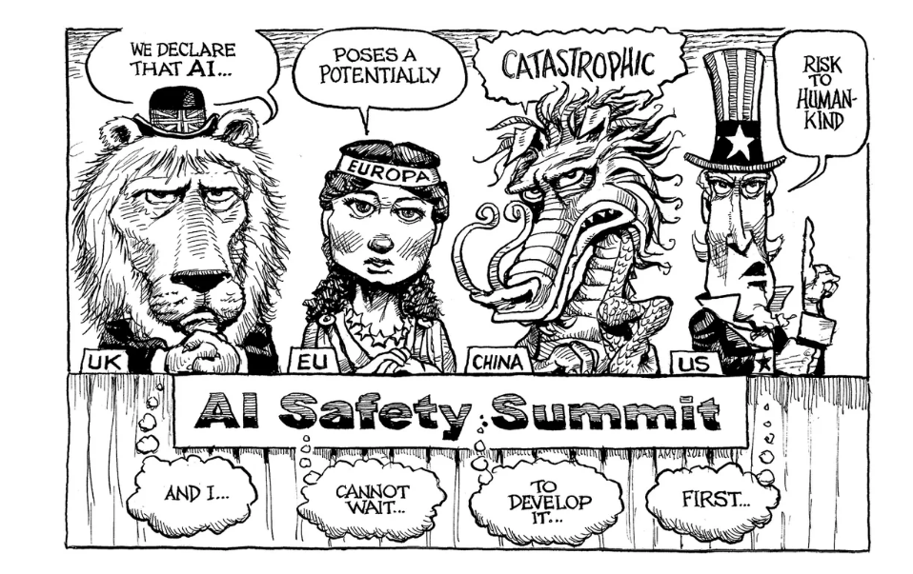
Potential vs. risk
KAL’s cartoons, The Economist, Nov. 2023

Slide 16
The implementation gap
Feeding all data to AI
The “right” data

Slide 17
The implementation gap: data
Accessibility
Quality
Relevance
Integration
“AI ready”
And many other issues that are many people’s life’s work

Slide 18
The implementation gap
AI advancement
Goal, process, talent update

Slide 19
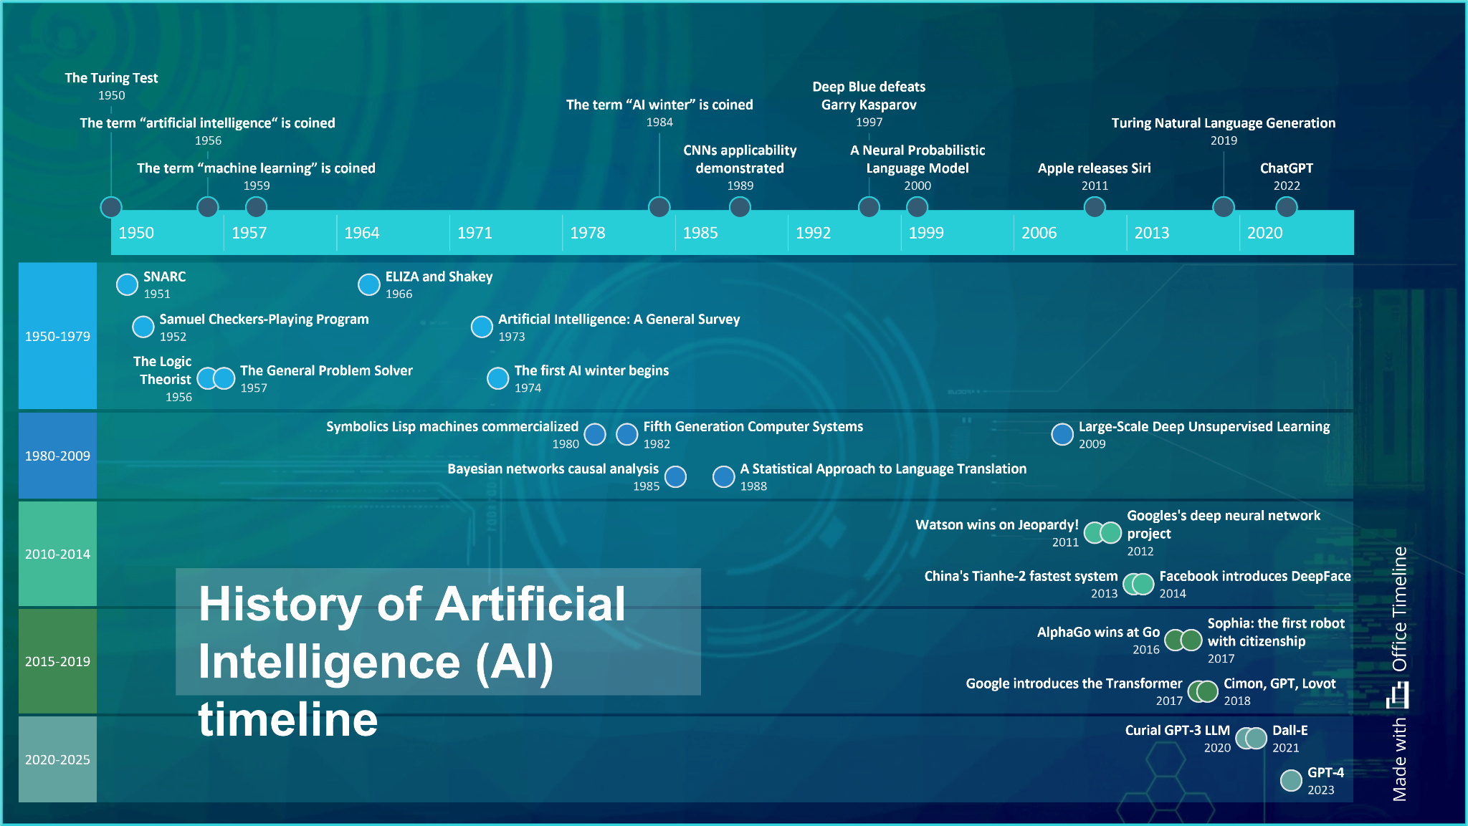
AI is moving “too fast”

Slide 20
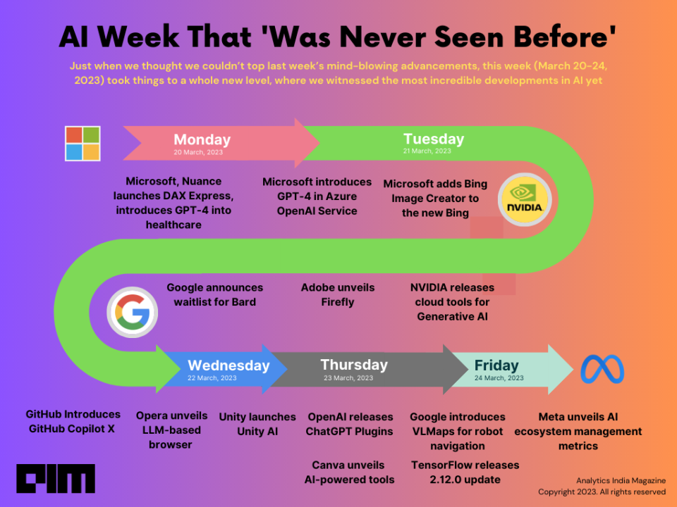
AI is moving “too fast”

Slide 21


AI is moving “too fast”
What about privacy in ChatGPT?
Local GPT !!!
What about context length?
Increased by at least 10 fold in a few months!!!

Slide 22
AI is moving “too fast”
What about mixing texts and images?
Multi-modal LLM !!!
What about adding specialized knowledge to the model?
Retrieval-augmented Generation!!!

Slide 23
And how soon will we see the next waves?
AGI???
Embodied
AI?
Generative
AI
Neurosymbolic
AI?
Interactive
AI?

Slide 24
The BIG implementation gap
Goal alignment
Process
Talent
Tool evaluation
Compliance
Risk management

Slide 25
The implementation gap
“Generic” AI
Specific needs

Slide 26

A garden of needs
Economic prediction
Elderly care
Personalized education
New materials
Human psychology
Manufacturing
Wildfire monitoring
Weather prediction
Finding new galaxies
Water quality
Proving math theorems
Autonomous vehicles
Animal behavior
Election monitoring
Drug discovery
Traffic control
Mental health
Equal access to healthcare

Slide 27
A garden of needs
Market prediction
Employee management
Professional development
R&D
Community giveback
Manufacturing
PR
Government relations
Accounting
Employee satisfaction
Talent recruiting
Customer service
Machinery maintenance
Scheduling
Client management
Computing resources
Supply chain
Energy efficiency

Slide 28
A garden of needs
Economic development
Elderly care
Education
Community
Workforce development
Supporting businesses
Sustainability
Protecting natural resources
Law enforcement
Water quality
Local politics
Transportation
Tax
Election monitoring
Digital access
Traffic control
Mental health
Equal access to healthcare

Slide 29

Stronger collaboration
Image credit: Dalle-3

Slide 30
Potential vs. Risk
Academia, industry and government collaboration throughout development and implementation
Defining and testing proper guardrails
Transparency and accessibility
Use-inspired research and development
“Third-party” assessment and validation
Equitable access
Image credit: Dalle-3

Slide 31
Potential vs. Risk
Example
Collaboration between the Michigan Institute for Data Science, Microsoft, Rocket Companies Ethical AI.
Image credit: Dalle-3

Slide 32
Upskilling
Training university professors and researchers together with industry and government data / AI developers and users.
Connecting developers and users with research breakthroughs.
Defining essential skills for the workforce of the future.
Image credit: Dalle-3

Slide 33
Upskilling
Examples
Joint postdoctoral and student training programs
Summer academies for data / AI developers and users
Students for industry and government research
Image credit: Dalle-3

Slide 34
Meeting specific needs
Research innovation
Co-development
Use cases
Image credit: Dalle-3

Slide 35
Meeting specific needs
Examples
Modifying industry-developed data / AI platforms for academic research use
Providing “sandboxes” for academic researchers
Co-develop data / AI tools
Image credit: Dalle-3

Slide 36
A garden of tools
Virtual instrumentation
Visualization
Simulation
Programming
Workflow design
Statistical analysis
Detecting errors
Pattern classification
Online updating
Modeling
Idea generation
Literature search
Experimental design
Data generation
Data integration
Data provenance
Data cleaning / formatting
Data discovery

Slide 37
Data and AI -driven knowledge assembly line
Design & optimization
Provenance
Access
Monitoring
Updating
Literature search
Primary
Secondary
Labeling / annotation
Modeling
Explainability
Experimentation
Query
Summary of status
Imputation and extrapolation
Statistics
Virtual instruments
Reporting
Scraping
Research design
Data fusion / formatting
Feature / pattern detection
Simulation
Selection
Problem
Data collection
Data processing
Analysis / modeling
Interpretation
Design & optimization
Provenance
Access
Monitoring
Updating

Slide 38
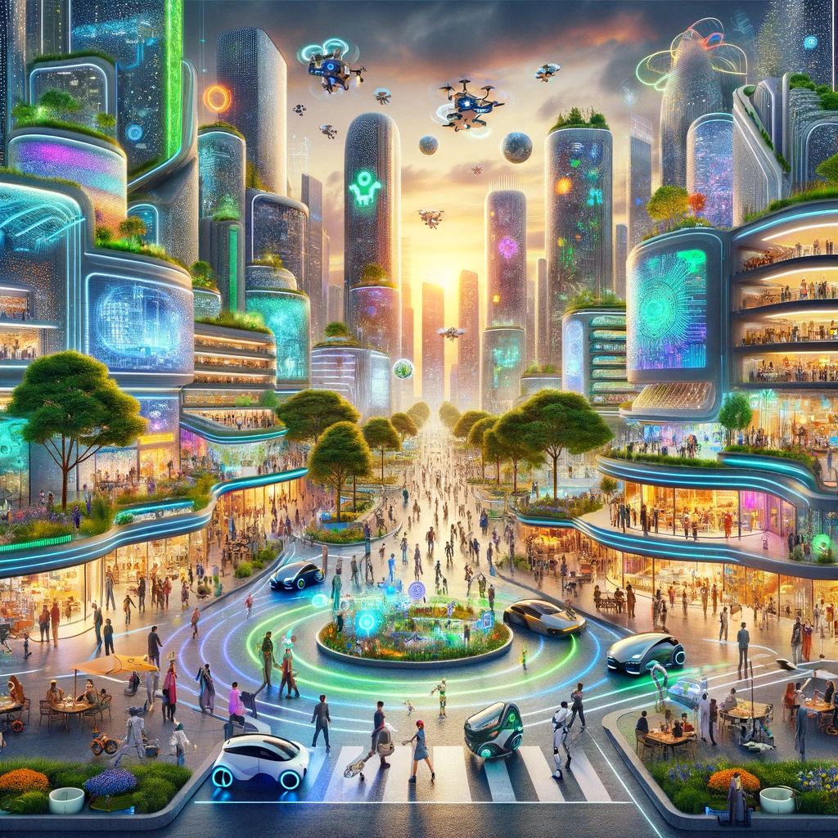
A different kind of future-ready
When a technology emerges at a massive scale and unprecedented speed, and when it has the potential to surpass human intelligence, we need new strategies.
We don’t need to panic. But we also can’t treat it just like other machines that we invented in the past.

