Slide 1

text

Slide 2
AI Copilots
The Future of Work is here
text

Slide 3
“Generative AI Copilot”
An advanced artificial intelligence system designed to collaboratively assist and augment human users in various tasks, leveraging generative capabilities to contribute actively to the creative and decision-making processes.
text

Slide 4
“Generative AI Copilot”
An advanced artificial intelligence system designed to collaboratively assist and augment human users in various tasks, leveraging generative capabilities to contribute actively to the creative and decision-making processes. This type of technology is customized for specific enterprise applications, learning from user interactions and context to provide tailored support.
text

Slide 5
“Generative AI Copilot”
An advanced artificial intelligence system designed to collaboratively assist and augment human users in various tasks, leveraging generative capabilities to contribute actively to the creative and decision-making processes. This type of technology is customized for specific enterprise applications, learning from user interactions and context to provide tailored support. It goes beyond conventional AI assistants by actively generating suggestions, solutions, or content in real-time, fostering a symbiotic relationship with users to enhance productivity, creativity, and problem-solving within organizational workflows.
text

Slide 6
What We’ll Cover
Emerging Trends
Recent News & Announcements
Design for Enterprise
Leading a Generative AI Initiative
text

Slide 7
“More than 92% of Fortune 500 companies use the OpenAI platform, up from 80% in August, and they span across industries such as financial services, legal applications and education.”
- Mira Murati, OpenAI CTO, 11/6/2023
text

Slide 8
What might Mira mean by “using the OpenAI platform”?
Broadest: Access to the platform. Experimenting with capabilities. Setting up accounts, trying out different models and tools, running pilot projects. May also include users of OpenAI-based third-party tools and APIs.
Building Internal Tools: For example, creating custom AI assistants / copilots, chatbots, or other automated content generation systems.
text

Slide 9
text

Slide 10
text

Slide 11
148.3 Million
24% Share
Trend & One-Year Projection:
Office Workers Using Generative AI Copilots
in an Enterprise Context
8.7 Million
1% Share
text

Slide 12
Key Developments
5/23 Anthropic raises $450 Million
7/11 Anthropic debut of Claude 2.0
7/12 Musk launches xAI
7/13 Bard adds audio responses & image search
7/18 Bing adds image search
8/28 ChatGPT launch of Enterprise
text

Slide 13
Key Developments
9/25 Amazon invests $4 Billion in Anthropic
9/25 ChatGPT adds audio and image capability
10/27 Google to invest $2 Billion in Anthropic
11/4 xAI launches Grok
11/6 OpenAI announces GPT-4 Turbo + GPT plug-ins
11/21 Anthropic announces Claude 2.1
text

Slide 14



text

Slide 15
Enterprise Context
Retrieval Augmented Generation (RAG)
Combine the strengths of retrieval and generative models.
More coherent and contextually-relevant responses.
text

Slide 16



Enterprise Context
Enterprise Data
Retrieval
Generation
GPT, etc.
text

Slide 17
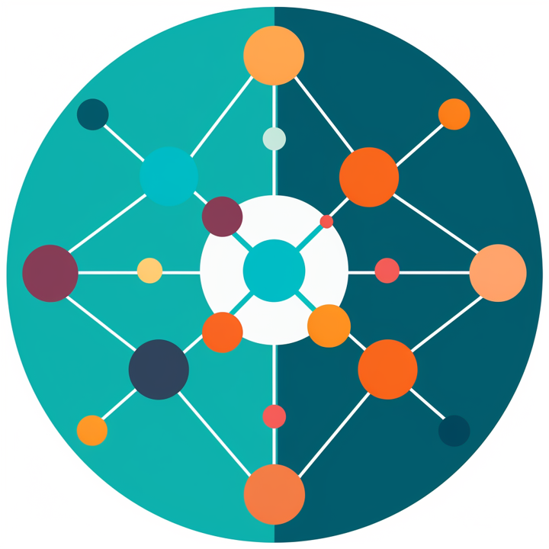
Knowledge Graph
A way to organize and connect information in a meaningful manner.
Entities (people, places, events)
Properties
Relationships
text

Slide 18

Vector Database
Enables similarity-based retrieval.
RAG can leverage this to retrieve similar documents or knowledge from your database, contributing to more informed and contextually relevant generation.
text

Slide 19
Full Enterprise Context
Knowledge
Graph
Enterprise Data
Vector
Database
Retrieval
Generation
GPT, etc.
text

Slide 20
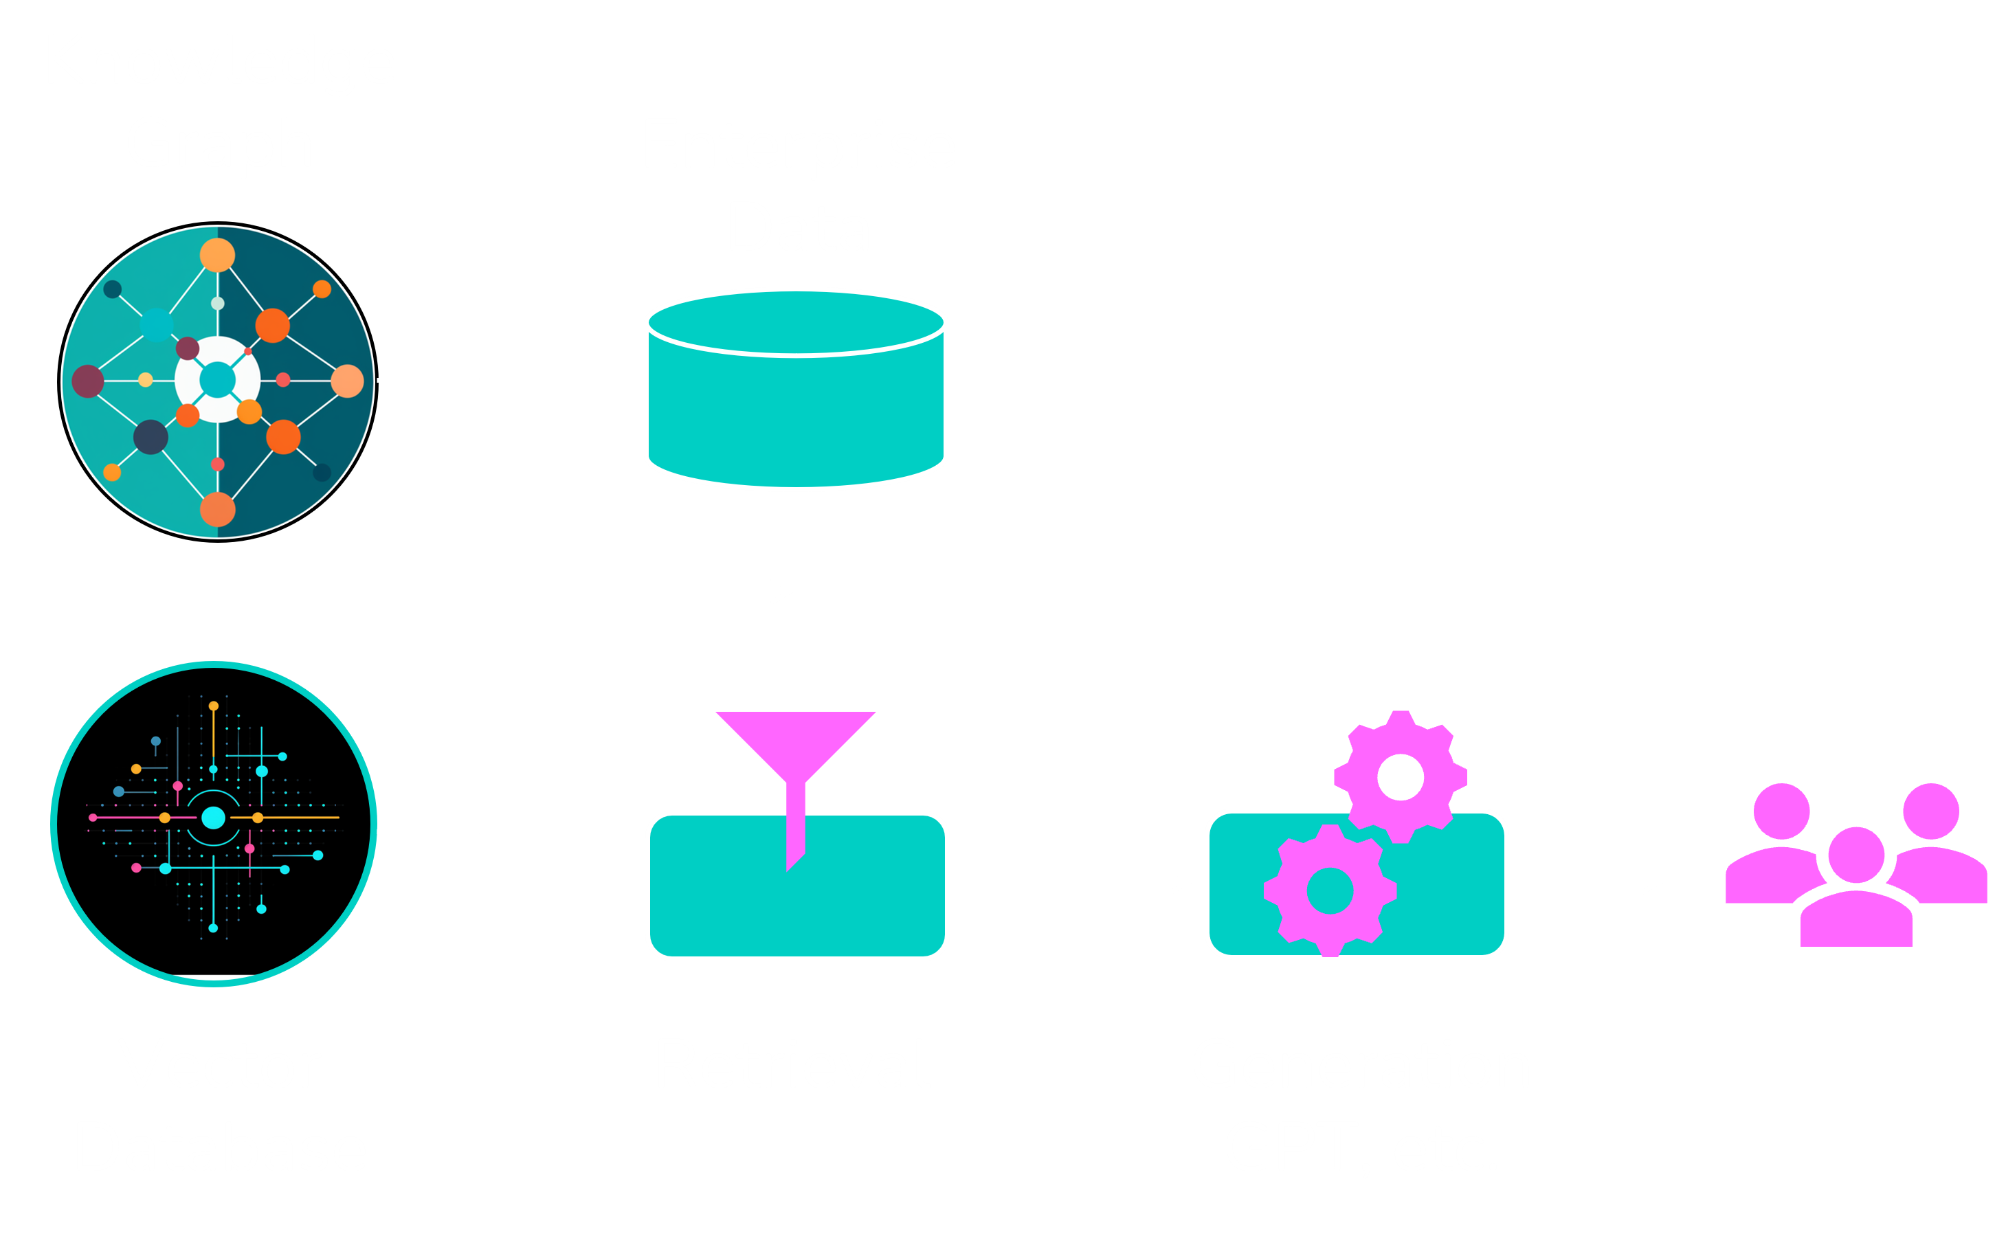
Typical Copilot Applications
Q&A Systems
Chatbots/ Virtual Assistants
Content Summaries
Content Creation
Enriched Knowledge Base
Front-Line Decision Support
text

Slide 21
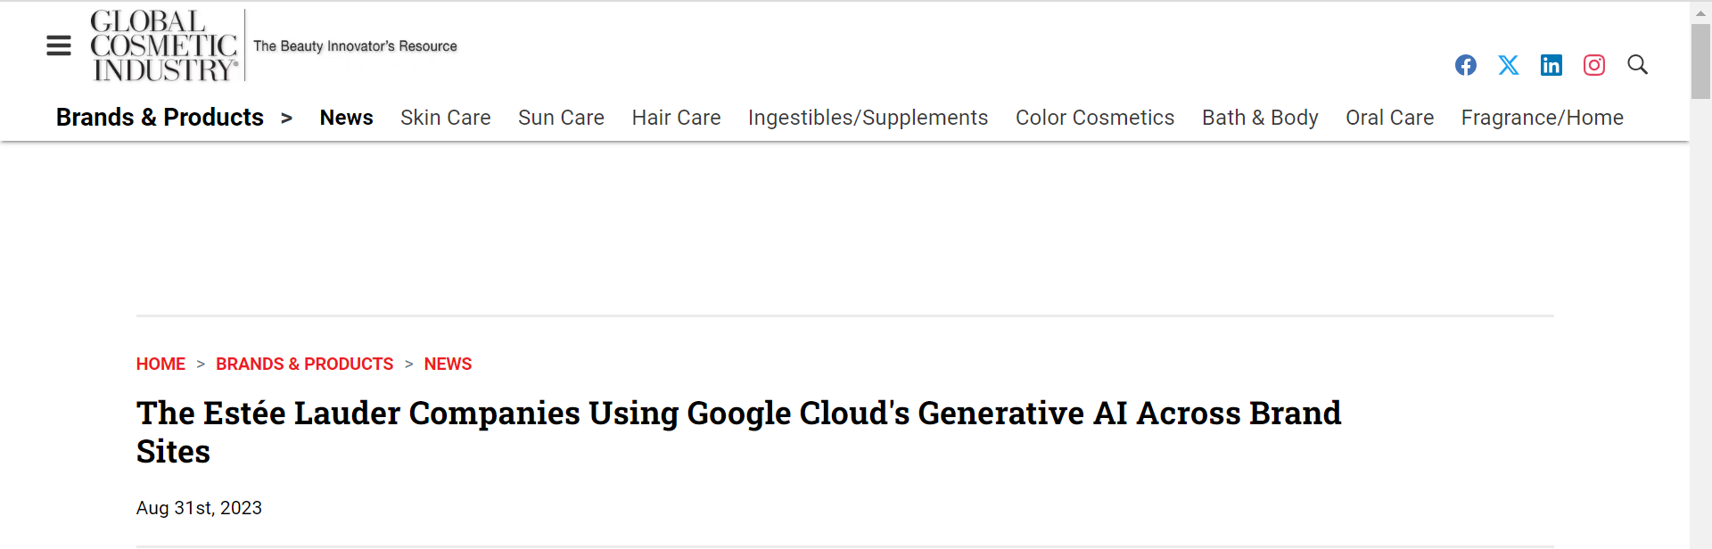
Last Week
text

Slide 22
Career Benefits
Who will spearhead your Gen AI projects? (Why not you?)
Strategic project, aligned to vision and goals
Thought leadership. Company & industry recognition
Cross-functional. Broader understanding of the enterprise
Showcase your problem-solving skills
Skill development & ML / NLP expertise. Continuous learning
text

Slide 23
HYPOTHETICAL SCENARIO
AI Use Cases for an Energy company, segmented by target initiative:
Productivity
  Flow Rate Prediction
  Downhole Pressure Optimization
  Breccia Image Classification
  Mean Grain Size Estimation
  Well Segmentation
  Demand Visibility Prediction
Efficiency
  Equipment Wear & Tear
  Predictive Maintenance
  Optimal Pump Down
  P&ID Drawing Extraction
  Instrumentation Issue Detection
  Material Master Search
Safety
  CV Enabled Asset Management
  Wellhole Prediction
  Structure Detection Identification
  Cable Tension Modeling
Environment
  Smart Power Notification
  Mine Aquifer Seepage
  Pipeline Integrity
The Path Forward
High
Sweet Spot
Future Investment
1.5
2.5
3.1
2.4
1.6
1.2
IMPACT
2.3
2.6
3.4
3.2
4.1
2.2
4.2
1.1
1.4
3.3
4.2
2.1
1.3
Experiment
Incubate
Low
Low
EFFORT
High
text

Slide 24


